Slide 1

USCS Data Boot Camp Project 4
Employee Attrition in Data Science
Using machine learning to predict if employees will leave employment
Team:
Richard Gu
Arsam Ijaz
Ronald Lam
Daniel Yoon
June 13, 2023

Slide 2
Introduction: Sources
Main Dataset
HR Analytics: Job Change of Data Scientists
https://www.kaggle.com/datasets/arashnic/hr-analytics-job-change-of-data-scientists?taskId=3015
27 US Employee Turnover Statistics [2023]: Average Employee Turnover Rate, Industry Comparisons, and Trends
https://www.zippia.com/advice/employee-turnover-statistics/#Employee_Turnover_Statistics_by_Industry
Research 1
Your people are quitting over a lack of training — here's what HR can do
https://www.hcamag.com/ca/specialization/employee-engagement/your-people-are-quitting-over-a-lack-of-training-heres-what-hr-can-do/416028
Research 2
Your Top Employees Are Learning New Skills on Their Own Time. Here's What You Should Do. https://www.entrepreneur.com/growing-a-business/your-top-employees-are-learning-new-skills-on-their-own/296636
Research 3
Research 4
The Surprising Reason People Quit Their Jobs That No One Talks About
https://www.visier.com/blog/the-surprising-reason-people-quit-their-jobs-that-no-one-talks-about/

Slide 3
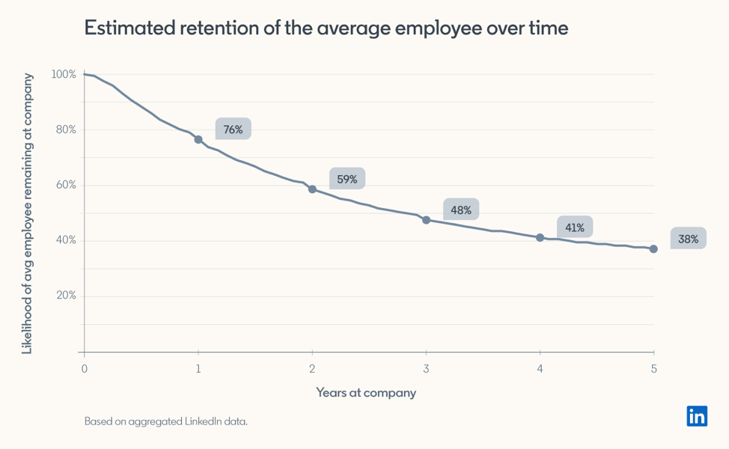
Introduction: Employee Retention
https://business.linkedin.com/talent-solutions/recruiting-tips/thinkinsights/retention-at-companies#:~:text=We%20looked%20at%2032%20million,years%2C%20a%2048%25%20chance.

Slide 4
Introduction: Turnover in Data Science
The average cost of replacing a salaried employee is 6 to 9 months of their salary. The overall cost of voluntary employee turnover amounted to over $1 trillion in 2022.
https://www.zippia.com/advice/employee-turnover-statistics/
Today’s data-science professionals will remain with their current employers a mere 1.7 years on average.
https://www.globenewswire.com/news-release/2021/10/15/2314725/0/en/Study-Reveals-High-Turnover-Rates-Among-Data-Science-Professionals.html

Slide 5
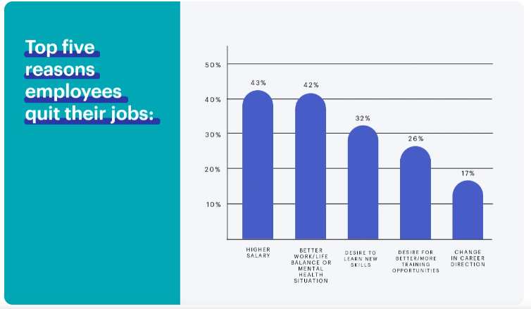
Introduction: Top 5 Reason Employees Quit
Higher salary - 43%
Better work/life balance or mental health situation - 42%
Desire to learn new skills - 32%
Desire for better/more training opportunities - 26%
Change in career direction - 17%
https://www.visier.com/blog/the-surprising-reason-people-quit-their-jobs-that-no-one-talks-about/

Slide 6

RRAD
Richard Ronald Arsam Daniel
UNDERSTANDING FEATURES
MACHINE LEARNING MODELS
PRE-PROCESSING
DATASET

Slide 7
Dataset
Most features categorical, few with high cardinality
one-hot encoding
binning
Varying degrees of missing values
drop all null values
Datawig
mode imputation
Imbalanced target value (roughly 25% positives or 1’s)
stratified splitting
oversampling
recall vs. accuracy
ROC AUC model evaluation
Target
0 = employees staying
1 = employees leaving
UNDERSTANDING FEATURES
MACHINE LEARNING MODELS
PRE-PROCESSING
DATASET

Slide 8

Workflow: Overview
4. Extract important features for visualization
1. Baseline Model
3. Evaluate different models
with cross validation
2. Handling missing data
UNDERSTANDING FEATURES
MACHINE LEARNING MODELS
PRE-PROCESSING
DATASET

Slide 9
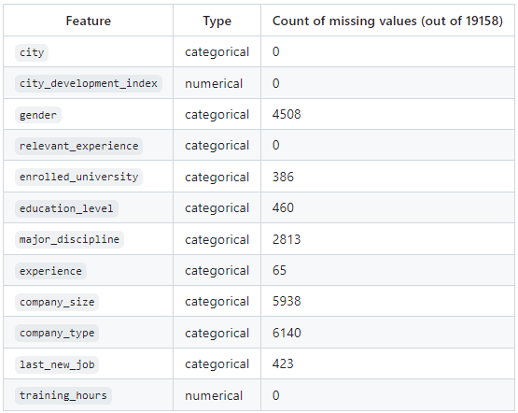
Workflow: Handling Missing Data
Summary of missing value counts of the original dataset
Methods | Rows Retained | ROC AUC | Recall
Drop null values | 8,955 | 0.73 | 0.63
Datawig | 18,014 | 0.72 | 0.69
Mode imputation | 19,158 | 0.74 | 0.74
Comparison of imputation methods
Evaluation done on a baseline logistic regression model
Mode imputation used for the remainder of the analysis
UNDERSTANDING FEATURES
MACHINE LEARNING MODELS
PRE-PROCESSING
DATASET

Slide 10
Workflow: Model Selection
Models: logistic regression model, supper vector with RBF kernel, random forest classifier
Method: stratified k-fold cross-validation (10 folds in total)
Pipeline components
stratified sampling
oversampling of minority target class
standardization
Model | ROC AUC | Recall
Logistic Regression | 0.78 | 0.73
RBF SVC | 0.77 | 0.72
Random Forest | 0.74 | 0.47
UNDERSTANDING FEATURES
MACHINE LEARNING MODELS
Comparison of cross-validated model performance
PRE-PROCESSING
DATASET

Slide 11
Workflow: Model Selection
Deep neural network with hyperparameter optimization
Metric objective: maximizing ROC AUC
ROC AUC: 0.80, recall: 0.75
59 features
100 units RELU
30 units RELU
40 units RELU
Sigmoid
Input Layer
Hidden Layer 1
Hidden Layer 2
Hidden Layer 3
Output Layer
UNDERSTANDING FEATURES
MACHINE LEARNING MODELS
PRE-PROCESSING
DATASET

Slide 12
Workflow: Feature Importance and Selection
Logistic regression important features
City development index
Relevant experience
Education level
Company size
Feature selection preserves (and improves) model performance
Model | ROC AUC | Recall
Logistic Regression | 0.78 (→) | 0.73 (→)
RBF SVC | 0.77 (→) | 0.73 (↑)
Random Forest | 0.74 (→) | 0.70 (↑)
UNDERSTANDING FEATURES
MACHINE LEARNING MODELS
Comparison of cross-validated model performance with feature selection
PRE-PROCESSING
DATASET

Slide 13
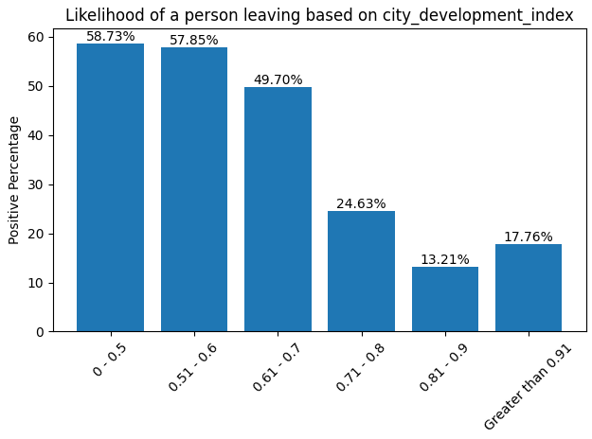
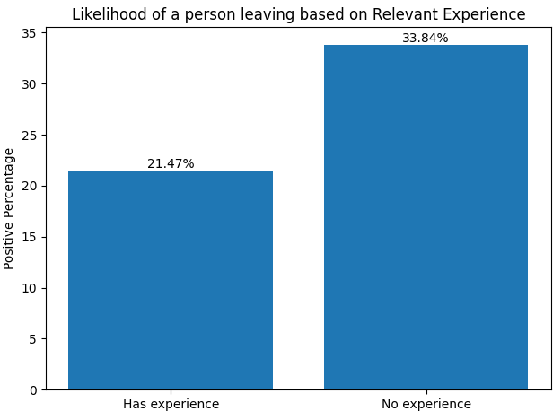
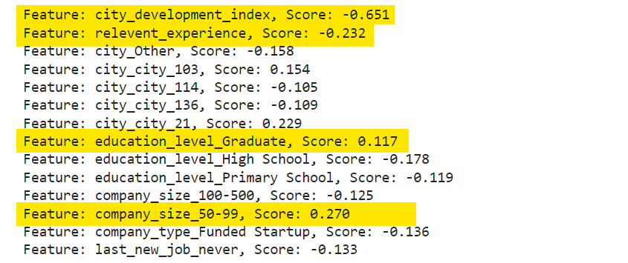
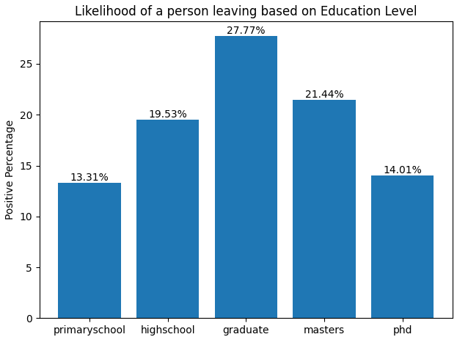
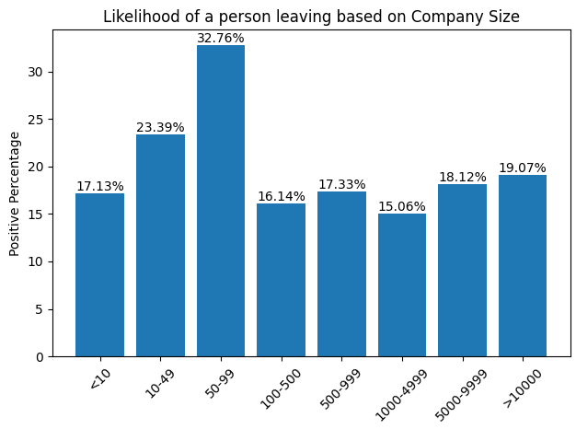
Feature Visualization
Logistic regression feature weights
UNDERSTANDING FEATURES
MACHINE LEARNING MODELS
PRE-PROCESSING
DATASET

Slide 14

Conclusions
Best model with and without feature selection
Logistic regression (0.78 ROC AUC and 0.73 recall)
Future Investigation
DNN is promising for delivering even better performance
Key Features
City development index, relevant experience, education level, and company size
Look-ahead
Choosing the right employees, the best form of training, and ensuring the optimal return

Slide 15
Thank you!
UNDERSTANDING FEATURES
MACHINE LEARNING MODELS
PRE-PROCESSING
DATASET

